Slide 1
STANDARD ELECTRODE POTENTIAL
d- BLOCK ELEMENTS

Slide 2
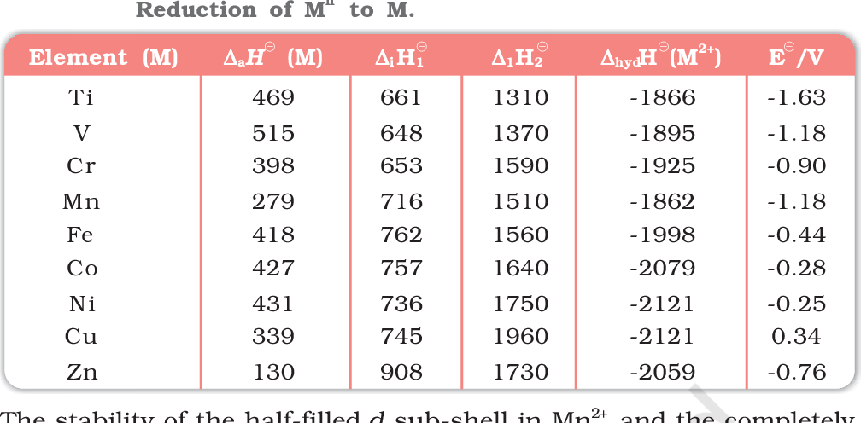

Slide 3
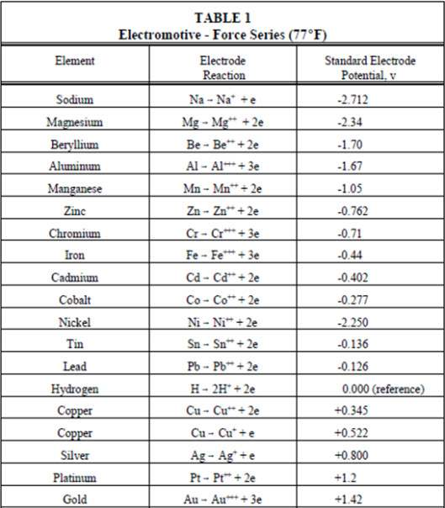

Slide 4
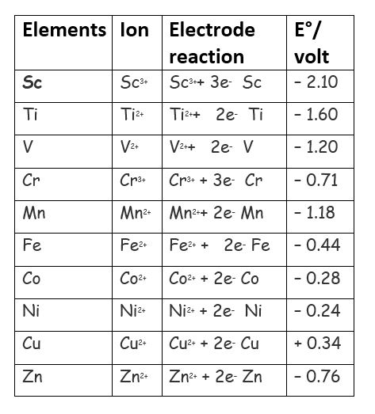

Slide 7
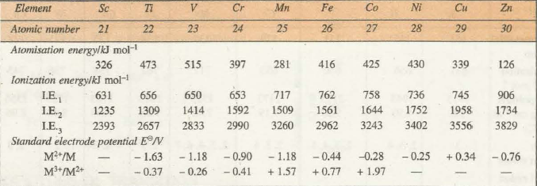

Slide 8
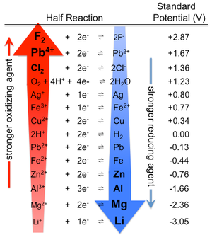

Slide 10
